Slide 1


<Shuhao Zhang>
<30/09/2022>
GitHub link: https://github.com/icepoloz/Python.git

Slide 2

Outline
Executive Summary
Introduction
Methodology
Results
Conclusion
Appendix

Slide 3
Executive Summary
Collect data from public SpaceX API and Wikipedia page.
Creat labels column ‘class’ classifying successful landing.
Explore date using SQL, visualization, maps, and dashboards.
Gather related columns to be used as features.
Change all categorical variables to binary using hot encoding
Process data and use GridSearchCV to look for best parameter for machine learning
Visualize the data
Use 4 machine learning models
All models can predict successful landings

Slide 4
Introduction
Project background:
SpaceY needs to compete with best company, SpaceX, in this industry
Problems you:
Train a machine learning model to predict successful Stage 1 recovery

Slide 5

Section 1

Slide 6
Methodology
Executive Summary
Data collection methodology:
Collect data from SpaceX public API and SpaceX Wikipedia page
Perform data wrangling
Classifying landings as successful and failed.
Perform exploratory data analysis (EDA) using visualization and SQL
Perform interactive visual analytics using Folium and Plotly Dash
Perform predictive analysis using classification models
Tuned models using GridSearchCV

Slide 7
Data Collection
Data collection process includes API requests and web scraping data.

Slide 8
Data Collection – SpaceX API
Request data from SpaceX API
.JSON file + Lists
Normalize data from JSON
Filter data to Falcon 9 only
Dictionary related data
Replace missing value with mean
https://github.com/icepoloz/Python/blob/a91300adf3e7c2d4621cd114e4bddbacf22da39d/jupyter-labs-spacex-data-collection-api.ipynb

Slide 9
Data Collection - Scraping
Request data from Wikipedia html
beautifulSoup html5lib Parser
Find launch info html table
Create dictionary
Extract data to dictionary
Cast dictionary to DataFrame
https://github.com/icepoloz/Python/blob/a91300adf3e7c2d4621cd114e4bddbacf22da39d/labs-jupyter-spacex-Data%20wrangling.ipynb

Slide 10
EDA with Data Visualization
Exploratory Data Analysis performed on variables Flight Number, Payload Mass, Launch Site, Orbit, Class and Year.
Plots Used: Flight Number vs. Payload Mass, Flight Number vs. Launch Site, Payload Mass vs. Launch Site, Orbit vs. Success Rate, Flight Number vs. Orbit, Payload vs Orbit, and Success Yearly Trend
Scatter plots, line charts, and bar plots were used to compare relationships between variables to
Decide if a relationship exists so that they could be used in training the machine learning model
https://github.com/icepoloz/Python/blob/a91300adf3e7c2d4621cd114e4bddbacf22da39d/jupyter-labs-eda-dataviz.ipynb

Slide 11
EDA with SQL
Loaded data set into IBM DB2 Database.
Queried using SQL Python integration.
Queries were made to get a better understanding of the dataset.
Queried information about launch site names, mission outcomes, various pay load sizes of customers and booster versions, and landing outcomes
https://github.com/icepoloz/Python/blob/a91300adf3e7c2d4621cd114e4bddbacf22da39d/sql%20notebook.ipynb

Slide 12
Build an Interactive Map with Folium
Folium maps mark Launch Sites, successful and unsuccessful landings, and a proximity example to key locations: Railway, Highway, Coast, and City.
This allows us to understand why launch sites may be located where they are. Also visualizes successful landings relative to location.
https://github.com/icepoloz/Python/blob/b15a72b3fb1d6035da04f35b5fcd306df65cd751/lab_jupyter_launch_site_location.ipynb

Slide 13
Build a Dashboard with Plotly Dash
Dashboard includes a pie chart and a scatter plot.
Pie chart can be selected to show distribution of successful landings across all launch sites and can be selected to show individual launch site success rates.
Scatter plot takes two inputs: All sites or individual site and payload mass on a slider between 0 and 10000 kg.
The pie chart is used to visualize launch site success rate.
The scatter plot can help us see how success varies across launch sites, payload mass, and
booster version category.
https://github.com/icepoloz/Python/blob/b15a72b3fb1d6035da04f35b5fcd306df65cd751/jupyter-labs-eda-dataviz.ipynb

Slide 14
Predictive Analysis (Classification)
Split label column ‘Class’ from dataset
GridSearchCV (10) to find optimal parameters
Use GridSearchCV on LogReg, SVM, Decision Tree, and KNN models
Fit and Transform Features using Standard Scaler
Score model on split test set
Confusion Matrix for all models
Barplot to compare scores of models
https://github.com/icepoloz/Python/blob/b15a72b3fb1d6035da04f35b5fcd306df65cd751/SpaceX_Machine%20Learning%20Prediction_Part_5.ipynb

Slide 15
Results
Exploratory data analysis results
Interactive analytics demo in screenshots
Predictive analysis results

Slide 16

Section 2

Slide 17
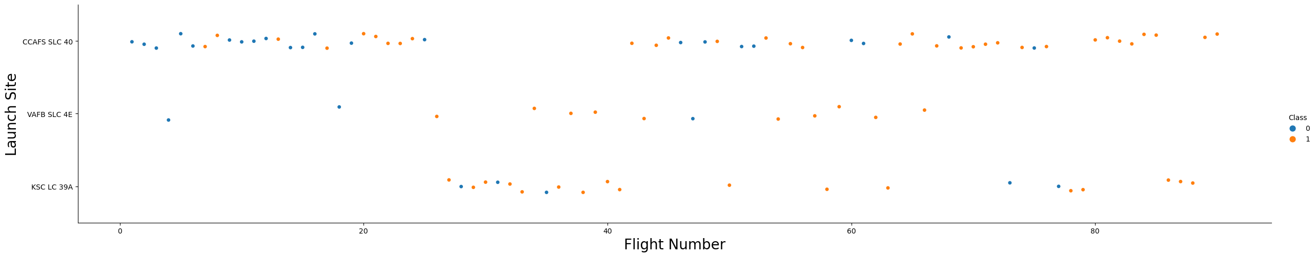
Flight Number vs. Launch Site
Orange means successful launch
Blue means unsuccessful launch
There is an increase in success rate over time (indicated in Flight Number). Likely a big breakthrough around flight 20 which significantly increased success rate. CCAFS appears to be the main launch site as it has the most volume.

Slide 18
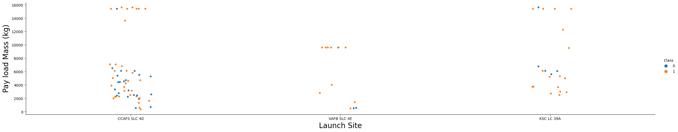
Payload vs. Launch Site
Orange means successful launch
Blue means unsuccessful launch
For the VAFB-SLC launchsite there are no rockets launched for heavypayload mass(greater than 10000).

Slide 19
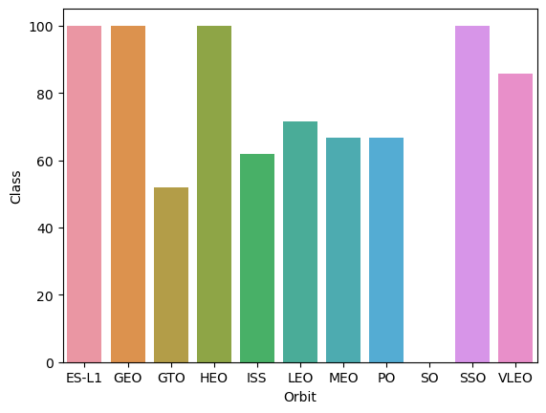
Success Rate vs. Orbit Type
ES-L1 (1), GEO (1), HEO (1) have 100% success rate (sample sizes in parenthesis) SSO (5) has 100% success rate
VLEO (14) has decent success rate and attempts
SO (1) has 0% success rate
GTO (27) has the around 50% success rate but largest sample

Slide 20
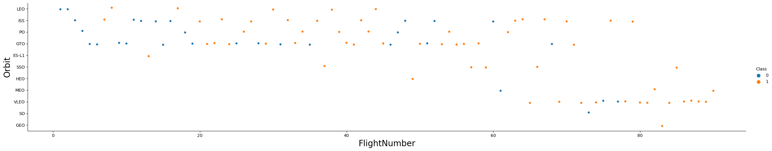
Flight Number vs. Orbit Type
Orange means successful launch
Blue means unsuccessful launch
LEO orbit the Success appears related to the number of flights; on the other hand, there seems to be no relationship between flight number when in GTO orbit.

Slide 21
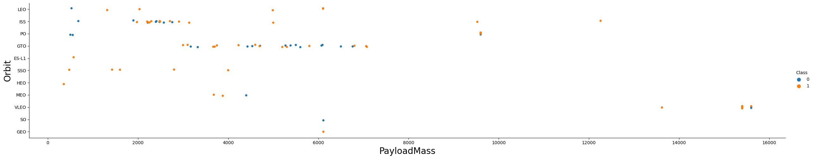
Payload vs. Orbit Type
Orange means successful launch
Blue means unsuccessful launch
With heavy payloads the successful landing or positive landing rate are more for Polar,LEO and ISS.
However for GTO we cannot distinguish this well as both positive landing rate and negative landing(unsuccessful mission) are both there here.

Slide 22
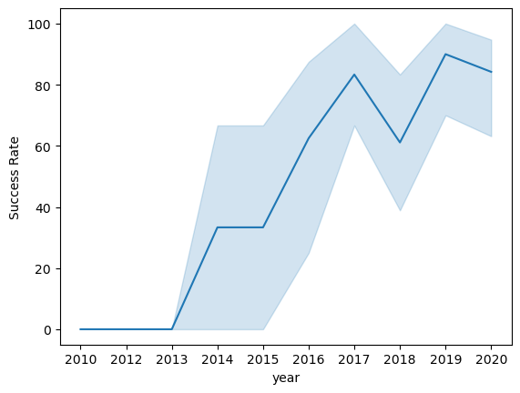
Launch Success Yearly Trend
Success generally increases over time from 2013 with a slight drop in 2018
Success in recent years at around 80%
95% confidence interval

Slide 23
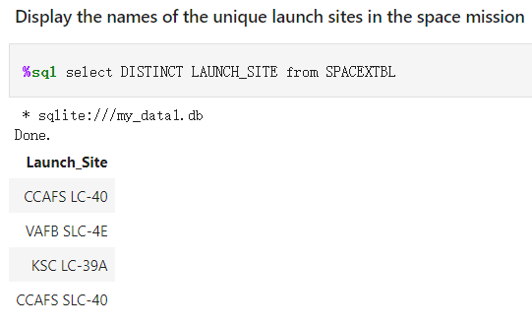
All Launch Site Names
Query unique launch site names from database.
CCAFS SLC-40 and CCAFSSLC-40 likely all represent the same
launch site with data entry errors.
CCAFS LC-40 was the previous name. Likely only 3 unique launch_site values: CCAFS SLC-40, KSC LC-39A, VAFB SLC-4E

Slide 24
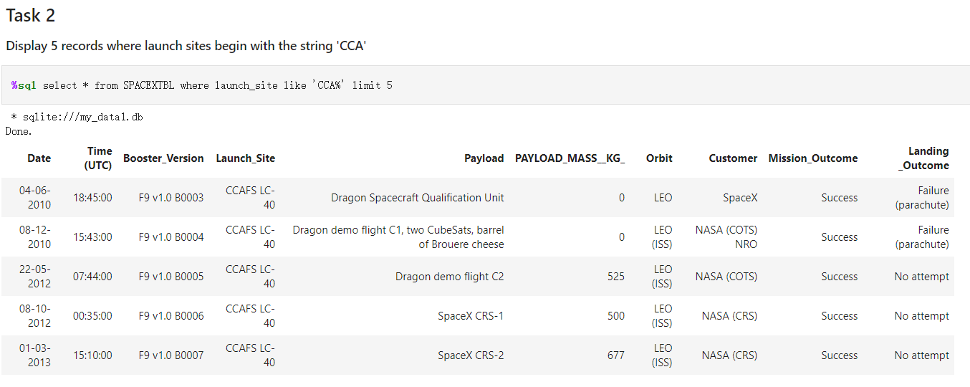
Launch Site Names Begin with 'CCA'
First five entries in database with Launch Site name beginning with CCA.

Slide 25
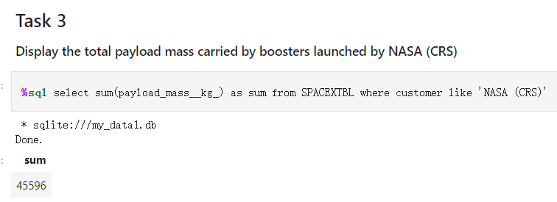
Total Payload Mass
This query sums the total payload mass in kg where NASA was the customer.
CRS stands for Commercial Resupply Services which indicates that these payloads were sent to the International Space Station (ISS).

Slide 26
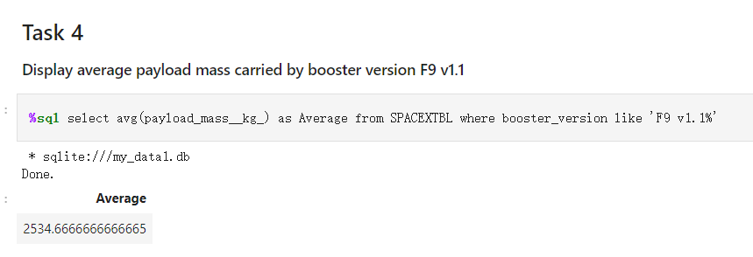
Average Payload Mass by F9 v1.1
This query calculates the average payload mass or launches which used booster version F9 v1.1
Average payload mass of F9 1.1 is on the low end of our payload mass range

Slide 27
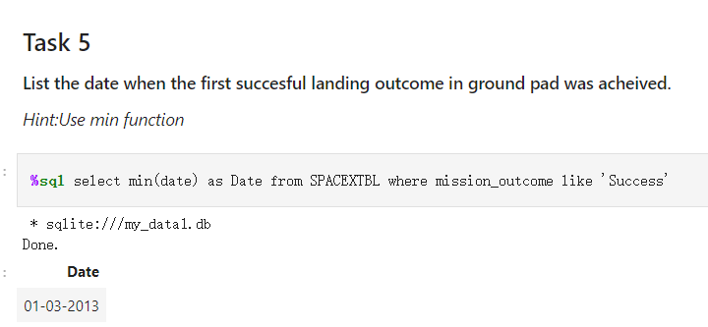
First Successful Ground Landing Date
This query returns the first successful ground pad landing date.

Slide 28
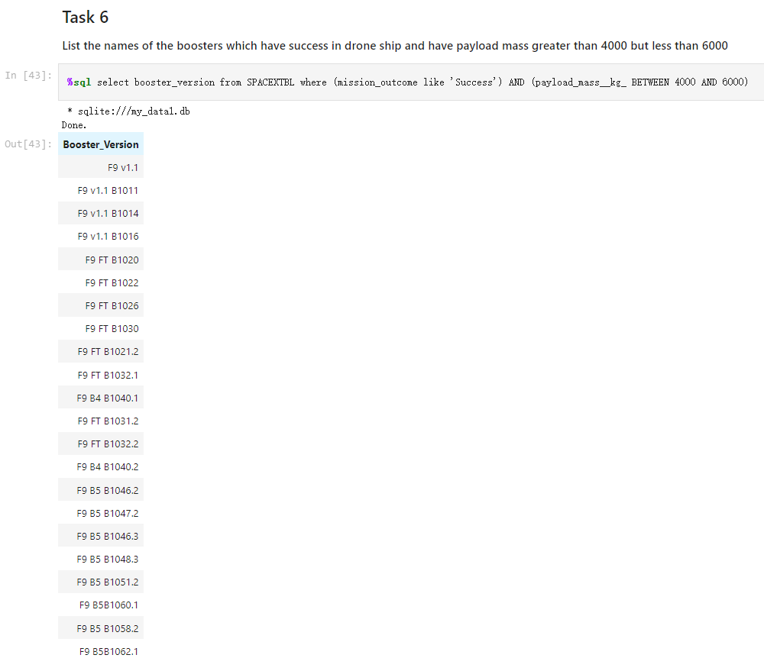
Successful Drone Ship Landing with Payload between 4000 and 6000
This query returns the all booster versions that had successful drone ship landings and a payload mass between 4000 and 6000 noninclusively.

Slide 29
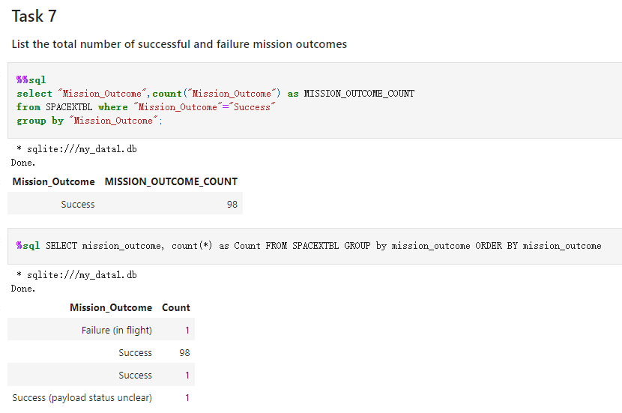
Total Number of Successful and Failure Mission Outcomes
This query returns a count of each mission outcome.
The mission is successful for 99%.

Slide 30
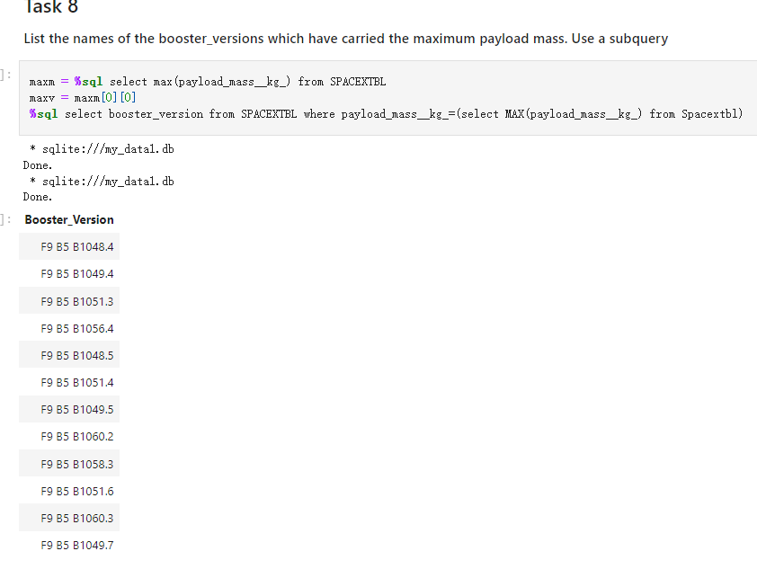
Boosters Carried Maximum Payload
This query returns the booster versions that carried the highest payload mass of 15600 kg.
These booster versions are very similar and all are of the F9 B5 B10xx.x variety.
This likely indicates payload mass correlates with the booster version that is used.

Slide 31
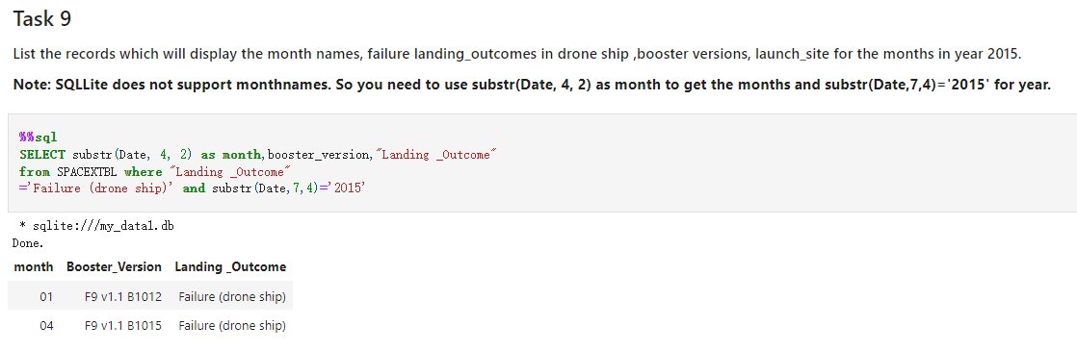
2015 Launch Records
This query returns the Month, Landing Outcome, Booster Version, Payload Mass (kg), and Launch site of 2015 launches where stage 1 failed to land on a drone ship.
There were two such occurrences.

Slide 32
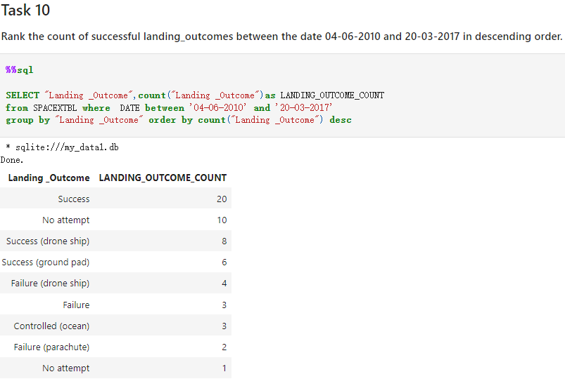
Rank Landing Outcomes Between 2010-06-04 and 2017-03-20
This query returns a list of successful landings and between 2010-06-04 and 2017-03-20 inclusively.
There are two types of successful landing outcomes: drone ship and ground pad landings.
There were 8 successful landings in total during this time period

Slide 33

Section 3

Slide 34
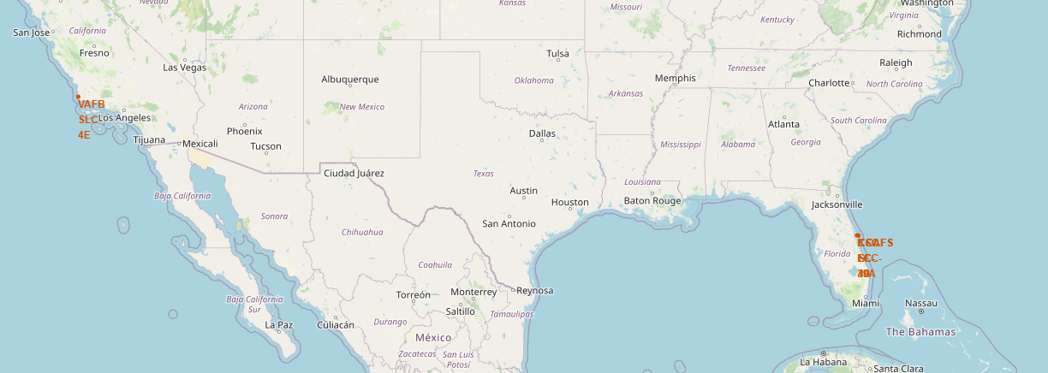
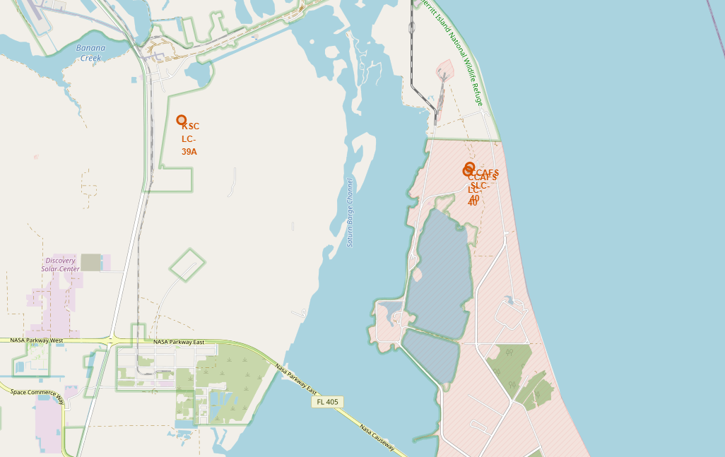
Launch Site Locations
The left map shows all launch sites relative US map.
The right map shows the two Florida launch sites since they are very close to each other.
All launch sites are near the ocean.

Slide 35
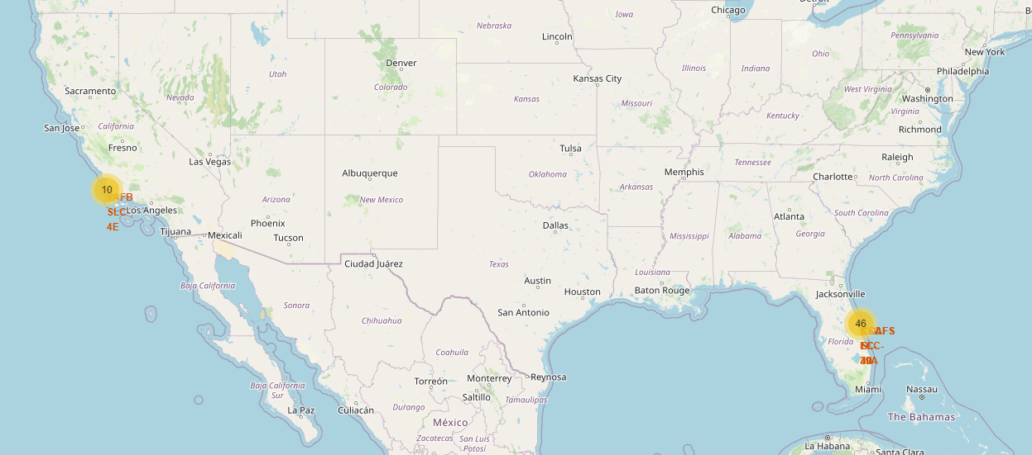
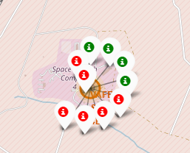
Color-Coded Launch Markers
Clusters on Folium map can be clicked on to display each successful landing (green icon) and failed
landing (red icon). In this example VAFB SLC-4E shows 4 successful landings and 6 failed landings.

Slide 36
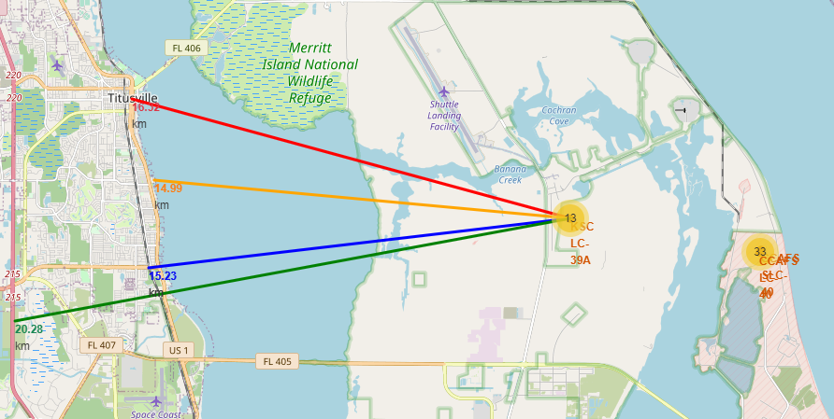
Key Location Proximities
The lines show the different distances between KSC LC-39A and other places

Slide 37

Section 5

Slide 38
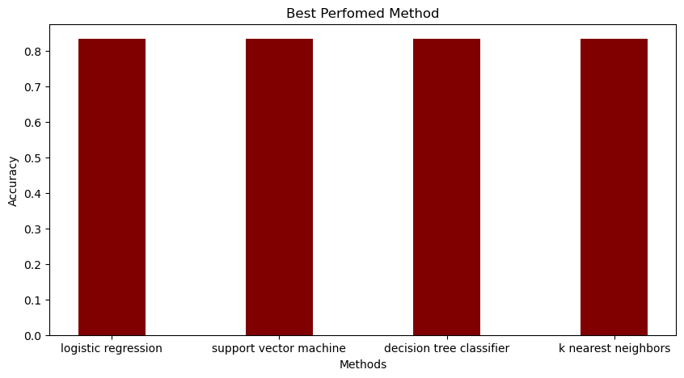
Classification Accuracy
All models had virtually the same accuracy on the test set at 83.33% accuracy.
It should be noted that test size is small at only sample size of 18.

Slide 39
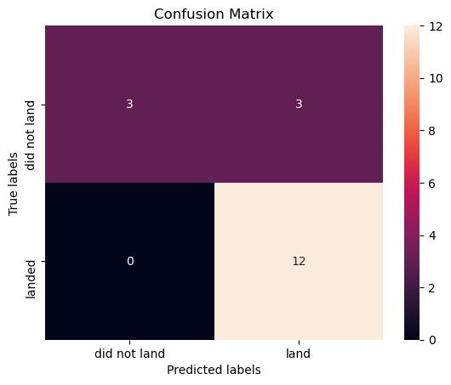
Confusion Matrix
Since all models performed the same for the test set, the confusion matrix is the same across all models.
The models predicted 12 successful landings when the true label was successful landing.
The models predicted 3 unsuccessful landings when the true label was unsuccessful landing.
The models predicted 3 successful landings when the true label was unsuccessful landings (false positives). Our models over predict successful landings.

Slide 40
Conclusions
Task: to develop a machine learning model for Space Y bidding against SpaceX
The goal of model is to predict when Stage 1 will successfully land to save ~$100 million USD
Used data from a public SpaceX API and web scraping SpaceX Wikipedia page
Created data labels and stored data into a DB2 SQL database
Created a dashboard for visualization
We created a machine learning model with an accuracy of 83%
Allon Mask of SpaceY can use this model to predict with relatively high accuracy whether a launch will have a successful Stage 1 landing before launch to determine whether the launch should be made or not
If possible more data should be collected to better determine the best machine learning model and improve accuracy

Slide 41


